Slide 1
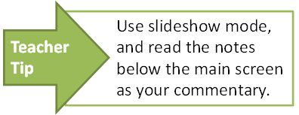
Roles and responsibilities of the three levels of government
State
Local
Federal

Slide 2




Three levels of government
Each level of government is responsible for providing different services..
Imagine if nobody knew what laws to obey, or if nobody was there to plan where roads should go or collect our rubbish!
We have three levels of government and three levels of law-making in Australia.
Governments at each level raise money through taxes or charges to pay for these services.

Slide 3
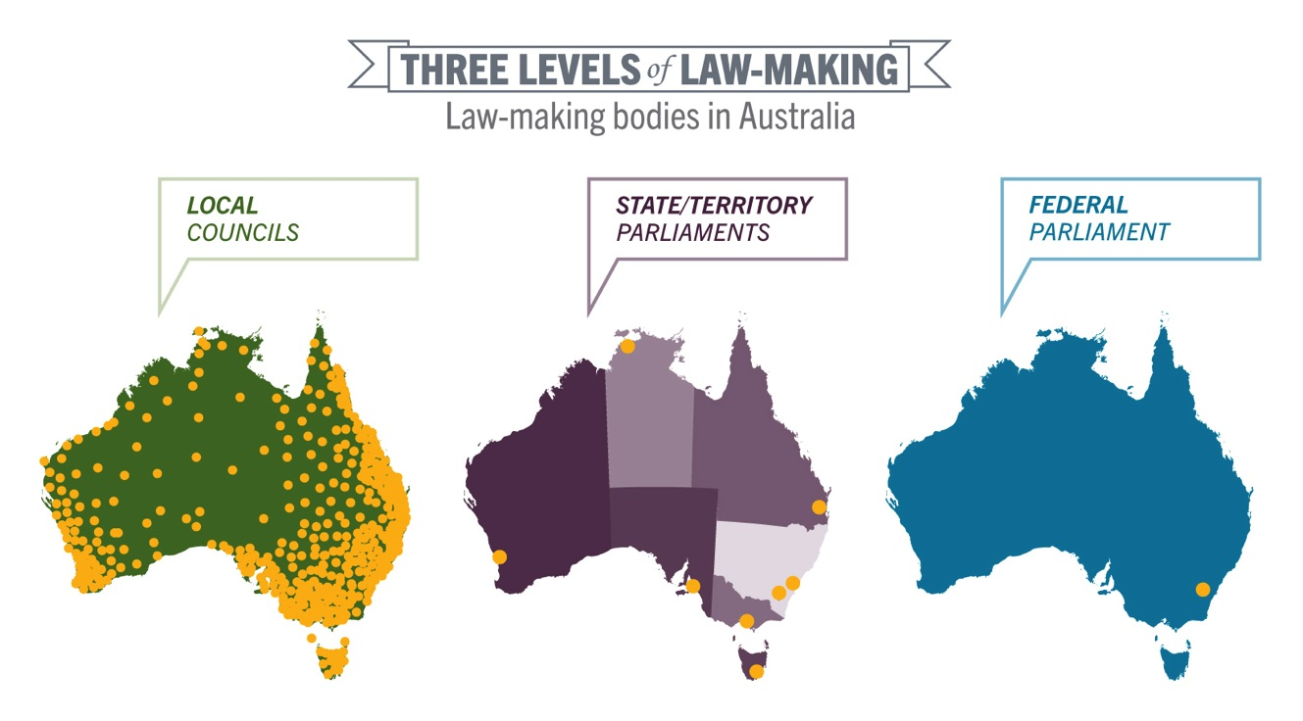
Three levels of law-making

Slide 4
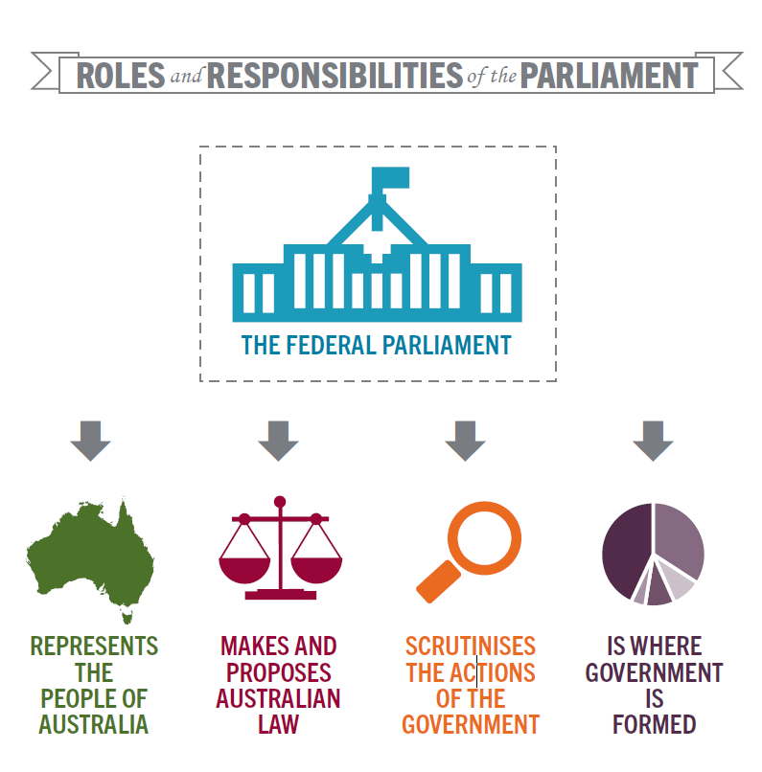
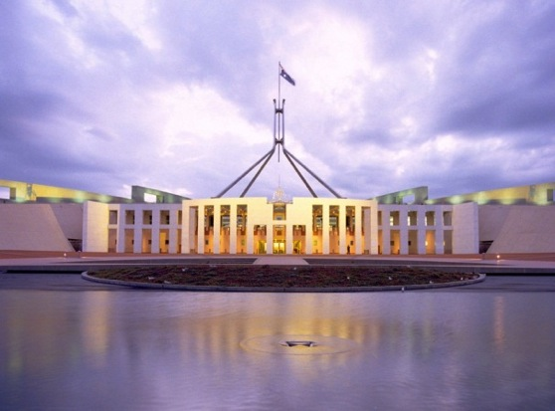
Federal government
Federal
Decision-making in relation to national issues takes place at Parliament House, Canberra.

Slide 5
Federal government
Federal
Who’s who in federal government?
Queen’s representative — Governor-General
Head of government — Prime Minister
Your representative — member of parliament
Representative of your state — senator
Responsibilities of the federal government:
defence forces
pensions
family support
imports and exports
quarantine
telecommunications
post
airports and air safety
income tax and company tax
foreign affairs
immigration
health, for example, Medicare
The role of the federal government is to:
provide services related to its responsibilities
make laws for the country.

Slide 6
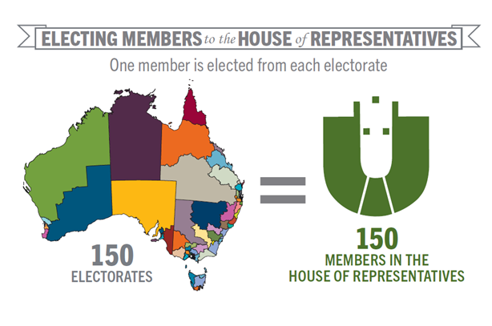
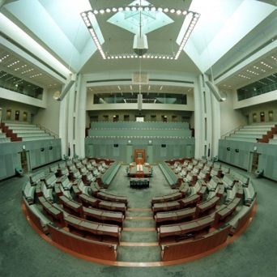
Role of the House of Representatives
Federal
The role of the House of Representatives is to:
make decisions about how the federal government will deliver services or meet its responsibilities
propose, debate and vote on bills and amendments
examine issues in committees
scrutinise executive government.
The party with the most representatives in this house forms government and selects the Prime Minister.

Slide 7
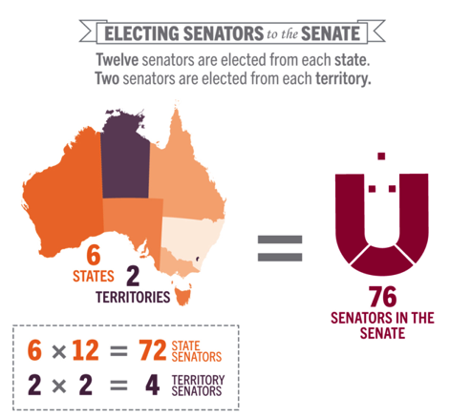
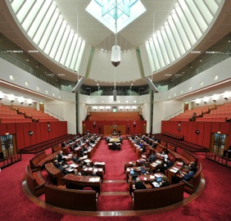
Role of the Senate
Federal
The role of the Senate is to:
review decisions about how the federal government will deliver services or meet its responsibilities
propose, debate and vote on bills and amendments
examine issues in committees
scrutinise the decisions of the executive*.
* The Senate is often called the ‘house of review’.

Slide 8
State/territory governments
State/Territory
Who’s who in state government?
Queen’s representative — Governor
Head of state government — Premier
Head of territory government — Chief Minister
Your representative — member of parliament
Responsibilities of state/territory governments:
education
health
environment
transport
public works
sport and recreation
police services
prisons
water
community services
industrial relations
primary industries.
The role of state/territory governments is to:
provide services related to its responsibilities
make laws that are enforced within their own state or territory.

Slide 9
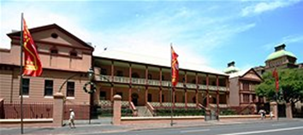
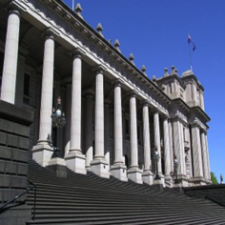
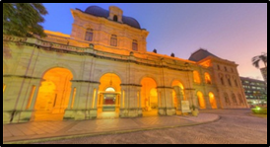
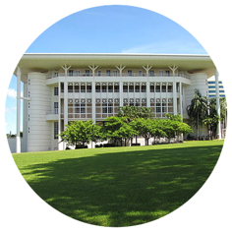
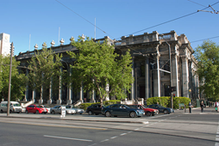
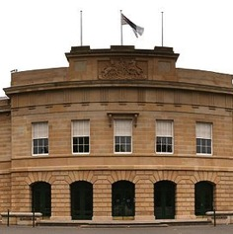
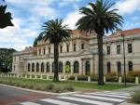
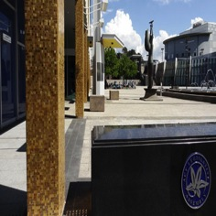
State and territory parliaments
State/Territory
i.
ii.
iii.
iv.
v.
vi.
vii.
viii.
All state parliaments, except Queensland, have two houses:
a lower house, called either the Legislative Assembly or House of Assembly
an upper house, called the Legislative Council.
The parliaments of Queensland, the Australian Capital Territory and Northern Territory only have a lower house, or Legislative Assembly.

Slide 10
Role of state and territory members of parliament
State/Territory
Members of state and territory parliaments have three main roles.
representing their electorate
working in the parliament
representing their political party or acting as an independent

Slide 11

Local government
Local
Who’s who in local government?
Queen’s representative — not applicable
Head of government — mayor, lord mayor or
shire president
Your representative — councillor
Responsibilities of the local government:
public property
local roads
local parks
swimming pools
new local roads and buildings
protection of natural areas and historic places
rubbish collection
street signs
pet control.
The role of local government is to:
provide services related to its responsibilities
make regulations and by-laws in relation to community needs.
There are over 560 councils in Australia.

Slide 12
Attributions
Slide 3:
Parliamentary Education Office (PEO) 2016, Three levels of law-making, http://www.peo.gov.au/uploads/image_gallery/the-law/PEO_0700_three-levels-law-making.pdf CC BY-NC-ND 3.0 creativecommons.org/licenses/by-nc-nd/3.0//
Slide 4:
Parliamentary Education Office (PEO) 2016, Roles and Responsibilities of the Parliament http://www.peo.gov.au/image-library/roles-and-responsibilities-of-the-parliament/214.html CC BY-NC-ND 3.0 creativecommons.org/licenses/by-nc-nd/3.0/
Parliament House, Canberra, copyright of the Commonwealth of Australia. http://www.peo.gov.au/multimedia/image-library/australias-parliament-house-il.html Used with permission.
Slide 6:
Parliamentary Education Office (PEO) 2016, Electing Members to the House of Representatives http://www.peo.gov.au/image-library/electing-members-to-the-house-of-representatives/214.html CC BY-NC-ND 3.0 creativecommons.org/licenses/by-nc-nd/3.0/
Photograph by David Foote. The House of Representatives chamber, http://www.peo.gov.au/image-library/the-house-of-representatives-chamber-empty/214.html Courtesy of Auspic.
Slide 7:
Parliamentary Education Office (PEO) 2016, Electing Senators, http://www.peo.gov.au/image-library/electing-senators-to-the-senate/214.html CC BY-NC-ND 3.0 creativecommons.org/licenses/by-nc-nd/3.0/
Photograph by David Foote , The Senate Chamber http://www.peo.gov.au/image-library/the-senate-chamber/214.html Courtesy of Auspic./
Slide 9:
i. OZinOH 2008, New South Wales State Parliament, http://www.flickr.com/photos/75905404@N00/2176368351/ CC BY-NC 2.0 creativecommons.org/licenses/by-nc/2.0/
ii. Donaldtong, Victoria Parliament Melbourne, http://commons.wikimedia.org/wiki/File:Victoria_Parliament_Melbourne_(Colonnades_%26_Stairs).jpg
iii. Queensland Parliament House http://www.parliament.qld.gov.au/~/media/Images/Common/Building/explore.ashx?h=250&mw=470&w=470 Image supplied by the Queensland Parliament
iv. Kenhodge13 2010, Northern Territory Legislative Assembly , https://www.flickr.com/photos/40132991@N07/4585077987/ CC BY 2.0 creativecommons.org/licenses/by/2.0/
v. Rexness 2010, Parliament House, Adelaide https://www.flickr.com/photos/rexness/5104234416/ CC BY-SA 2.0 creativecommons.org/licenses/by-sa/2.0/
vi. Chuq, Parliament House, Hobart, Tasmania http://commons.wikimedia.org/wiki/File:CG-ParliamentHouseHobart.jpg
vii. Purple Wyrm 2008, Western Australian Parliament, https://www.flickr.com/photos/wyrmworld/3047916980/ CC BY-NC-SA 2.0 creativecommons.org/licenses/by-nc-sa/2.0/
viii. ACT Legislative Assembly http://www.parliament.act.gov.au/__data/assets/image/0009/358821/home_feature.jpg CC BY-NC-ND 3.0 AU creativecommons.org/licenses/by-nc-nd/3.0/au/
References:
Three levels of government (Everyone’s parliament ) https://www.parliament.qld.gov.au/documents/explore/education/factsheets/Factsheet_1.1_ThreeLevelsOfGovt.pdf
Parliamentary Education Office http://www.peo.gov.au/multimedia/image-library/the-parliament.html
Fact Sheets (Parliamentary Education Office) http://www.peo.gov.au/learning/fact-sheets.html

